Slide 1
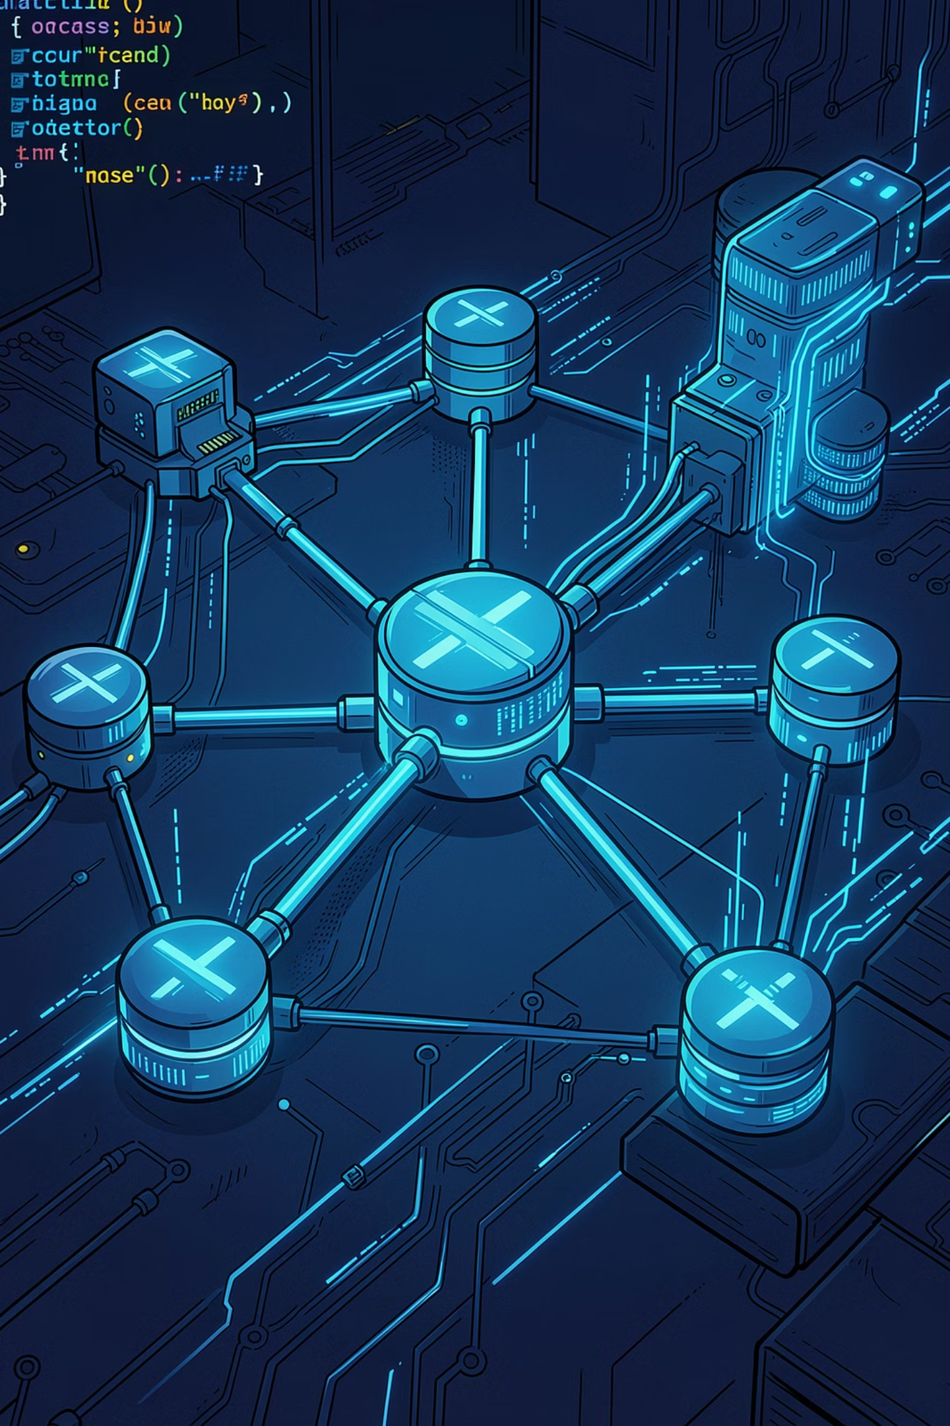
EF Core Fundamentals
A Beginner's Guide to ORM in .NET — your foundation for building the Quiz App backend
PPT 1 OF 2
BEGINNER FRIENDLY

Slide 2
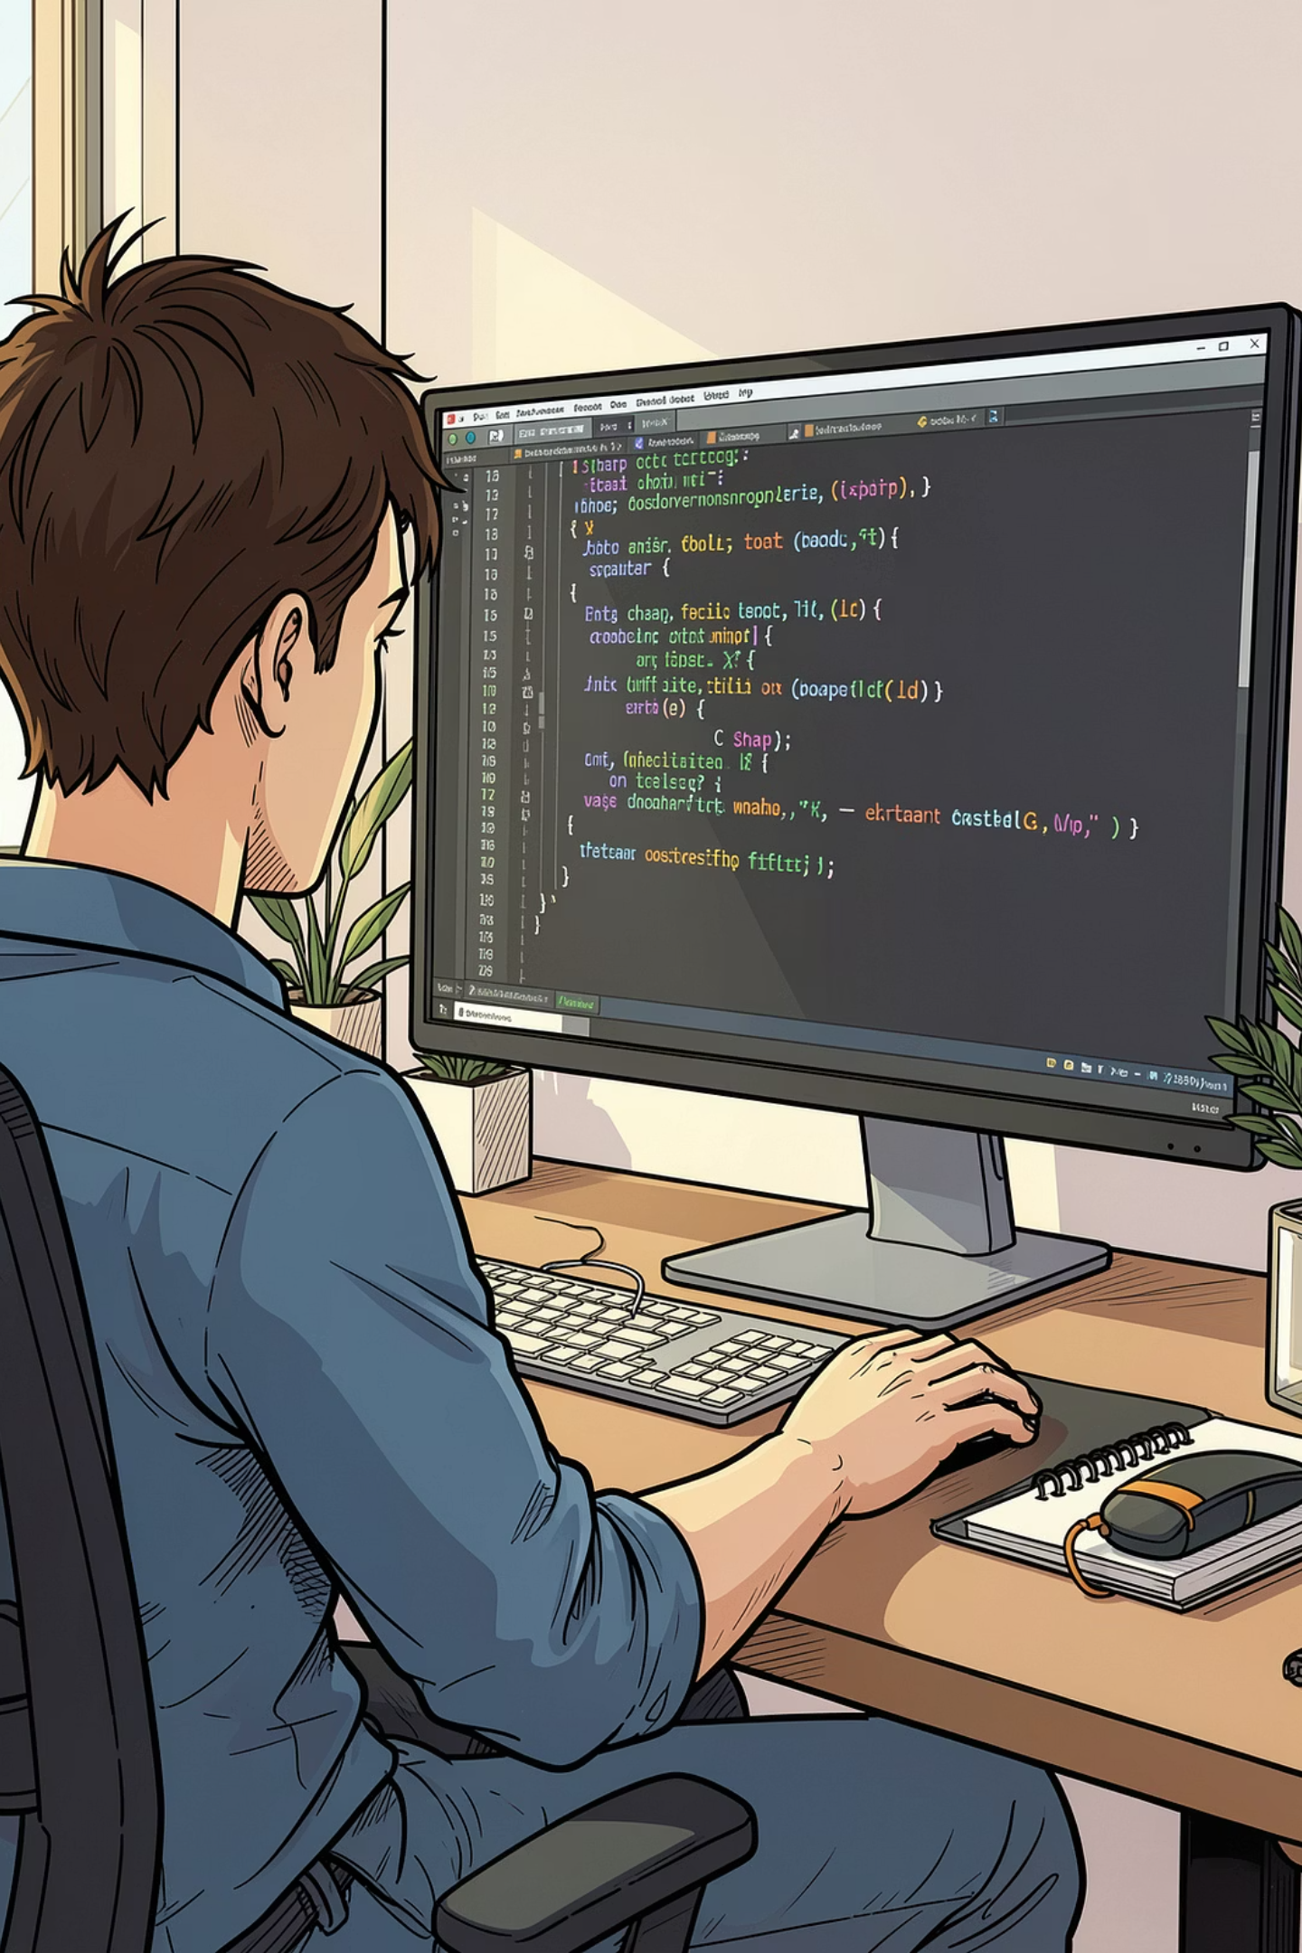
What is EF Core?
Entity Framework Core is a modern, cross-platform Object-Relational Mapper (ORM) for .NET. It bridges your C# code and your database — automatically.
Maps Classes → Tables
No Raw SQL
Write queries in C# using LINQ, not SQL strings
C# classes become database tables without manual SQL
Open Source
Lightweight, cross-platform, actively maintained by Microsoft

Slide 3


Why Choose EF Core?
Productivity Boost
Less boilerplate SQL — focus on business logic, not query strings
Strongly Typed LINQ
Catch errors at compile time with IntelliSense support
Schema Evolution
Migrations track database changes like Git tracks code
Multi-Database Support
SQL Server, SQLite, PostgreSQL, MySQL — swap with minimal changes

Slide 4
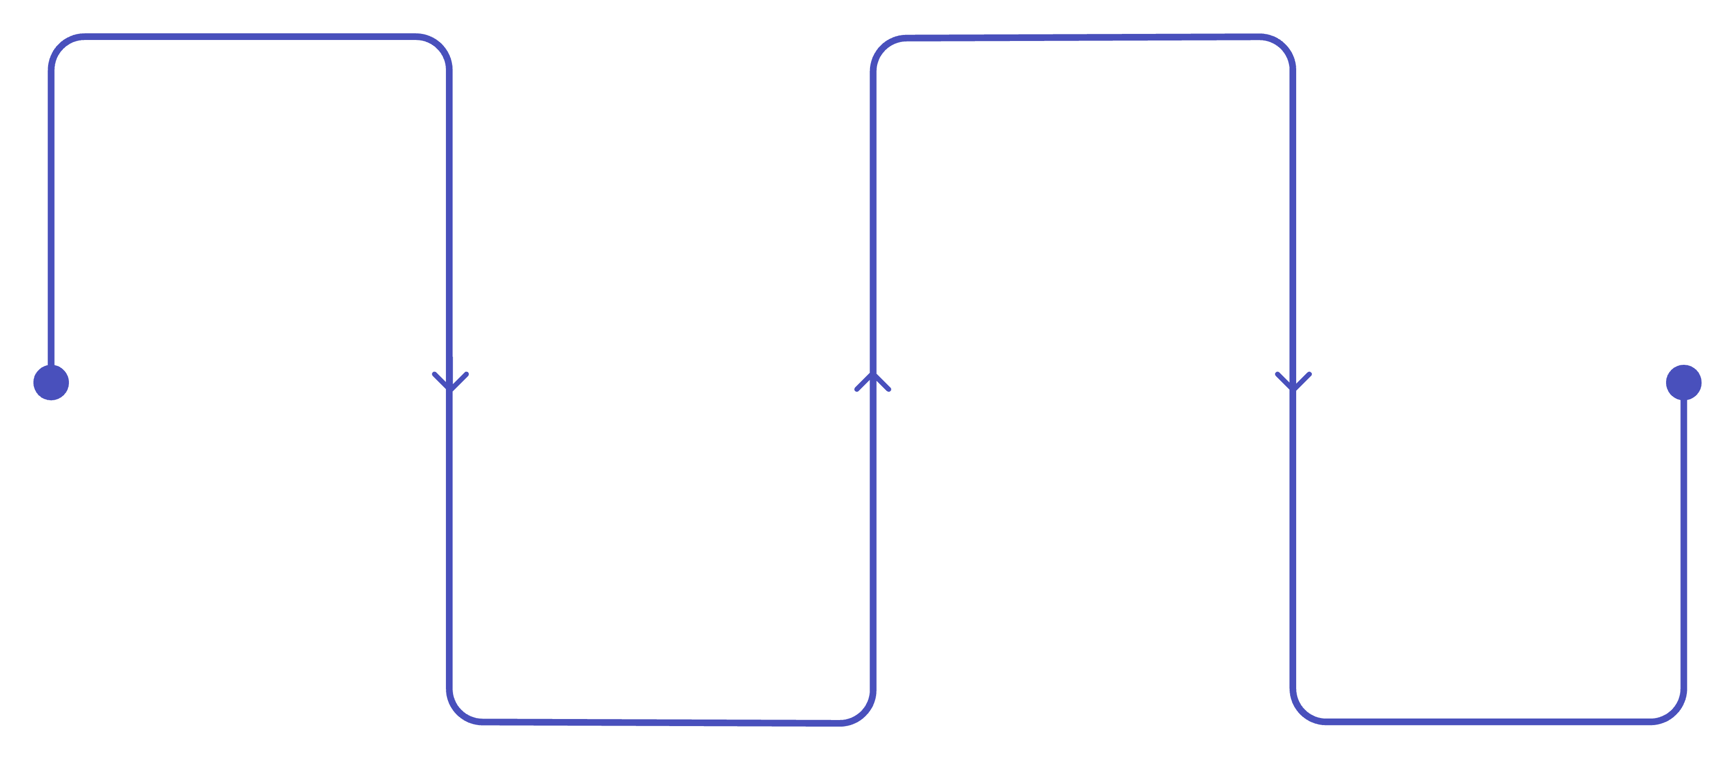
Getting Started
Four steps to get EF Core running in your Quiz App project:
Install Package
Create DbContext
dotnet add package Microsoft.EntityFrameworkCore
Implement DbContext with DbSet properties
Define Entities
Configure Connection
Create POCOs like Question and User
Add connection string and setup in Program.cs
EF Core is ready to map your C# objects to a real database in minutes — no complex setup required.

Slide 5

DbContext — The Heart of EF Core
What Does DbContext Do?
Quiz App Example
Manages the database connection
Tracks changes to all entities
Coordinates saving data with SaveChanges()
Exposes DbSet<T> properties for each table
public class QuizDbContext : DbContext
{
public DbSet<Question> Questions { get; set; }
public DbSet<User> Users { get; set; }
public DbSet<QuizResult> Results { get; set; }
protected override void OnConfiguring(
DbContextOptionsBuilder options)
=> options.UseSqlServer(
"your-connection-string");
}
Think of DbContext as your app's session with the database — it knows everything happening during a request.

Slide 6
Entity Classes — POCOs
Plain Old CLR Objects — simple C# classes that EF Core maps to database tables. No special base classes needed.
public class Question
{
public int Id { get; set; } // Primary Key
public string Text { get; set; }
public string Category { get; set; }
public int Difficulty { get; set; }
// Navigation property
public List<Answer> Answers { get; set; }
}
public class Answer
{
public int Id { get; set; }
public string Text { get; set; }
public bool IsCorrect { get; set; }
// Foreign Key relationship
public int QuestionId { get; set; }
public Question Question { get; set; }
}

Slide 7
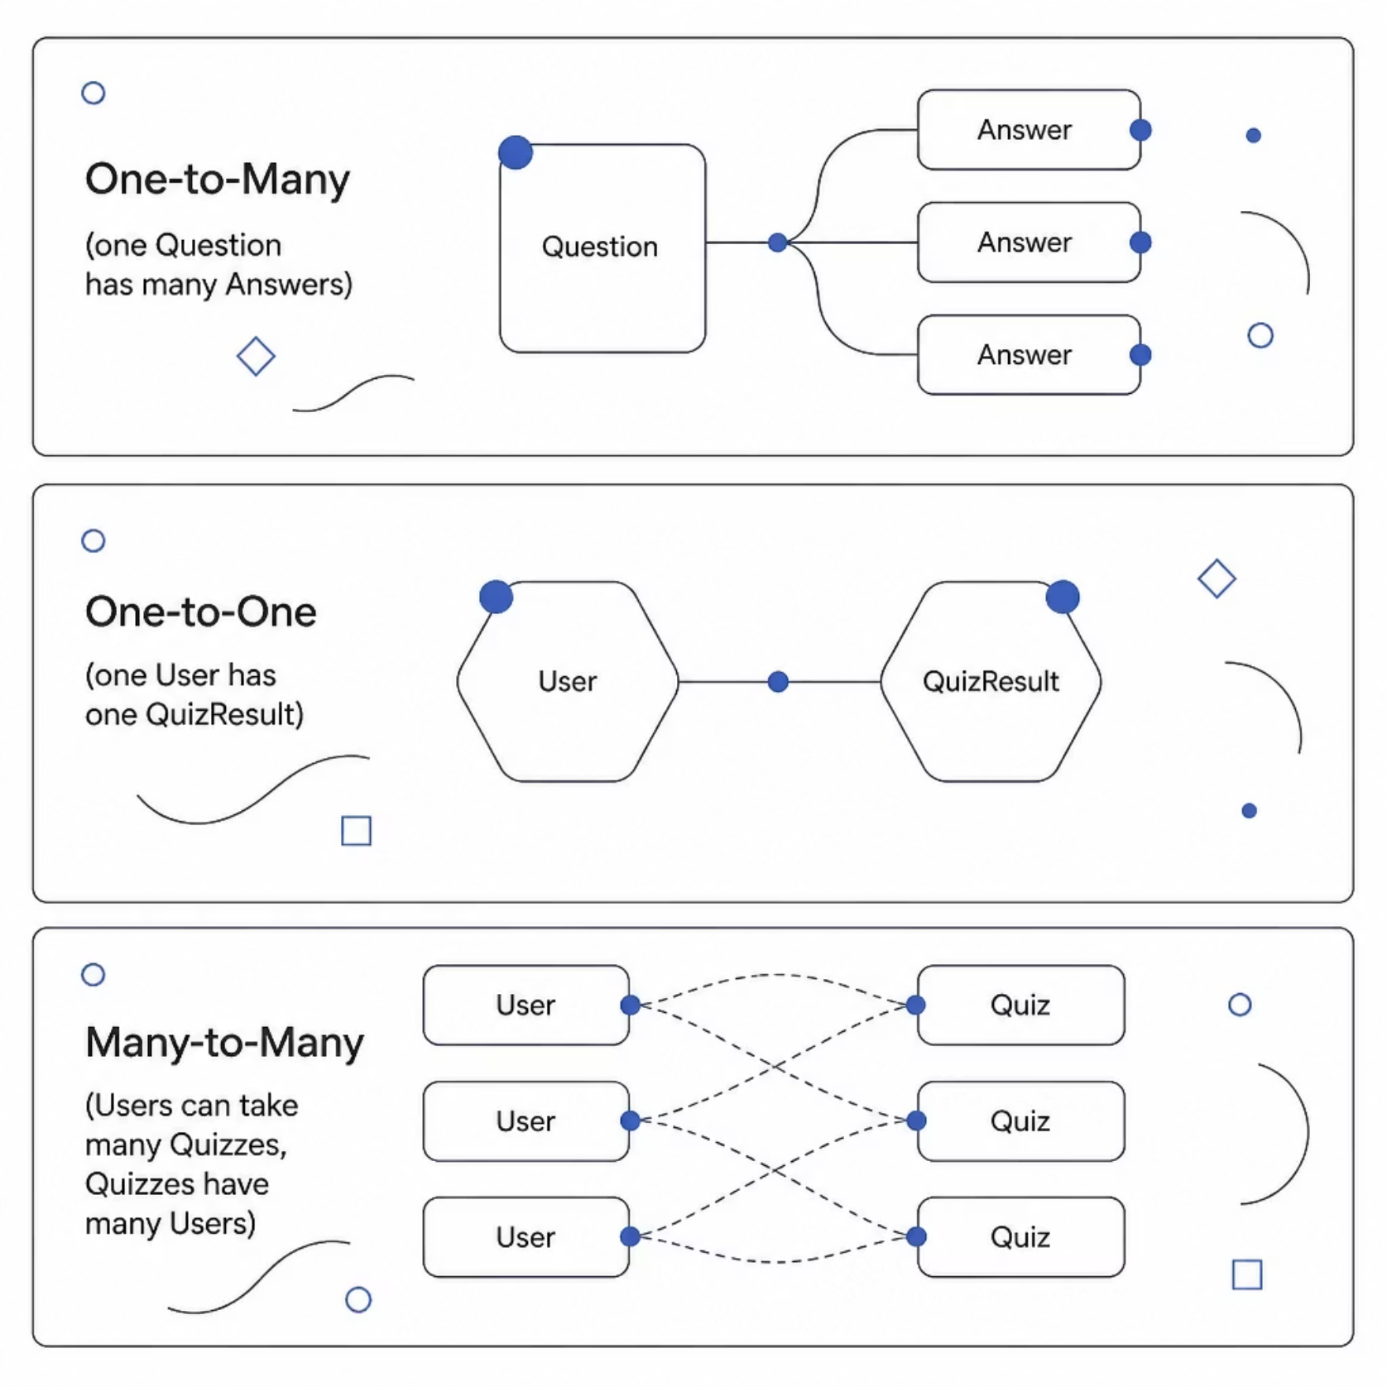

Model Building & Relationships
EF Core gives you three ways to configure your model — from simple to advanced:
Conventions
EF auto-detects Id as primary key and names tables from class names
Data Annotations
Add [Key], [Required], [MaxLength(500)] directly on properties
Fluent API
Full control in OnModelCreating — ideal for complex relationships

Slide 8
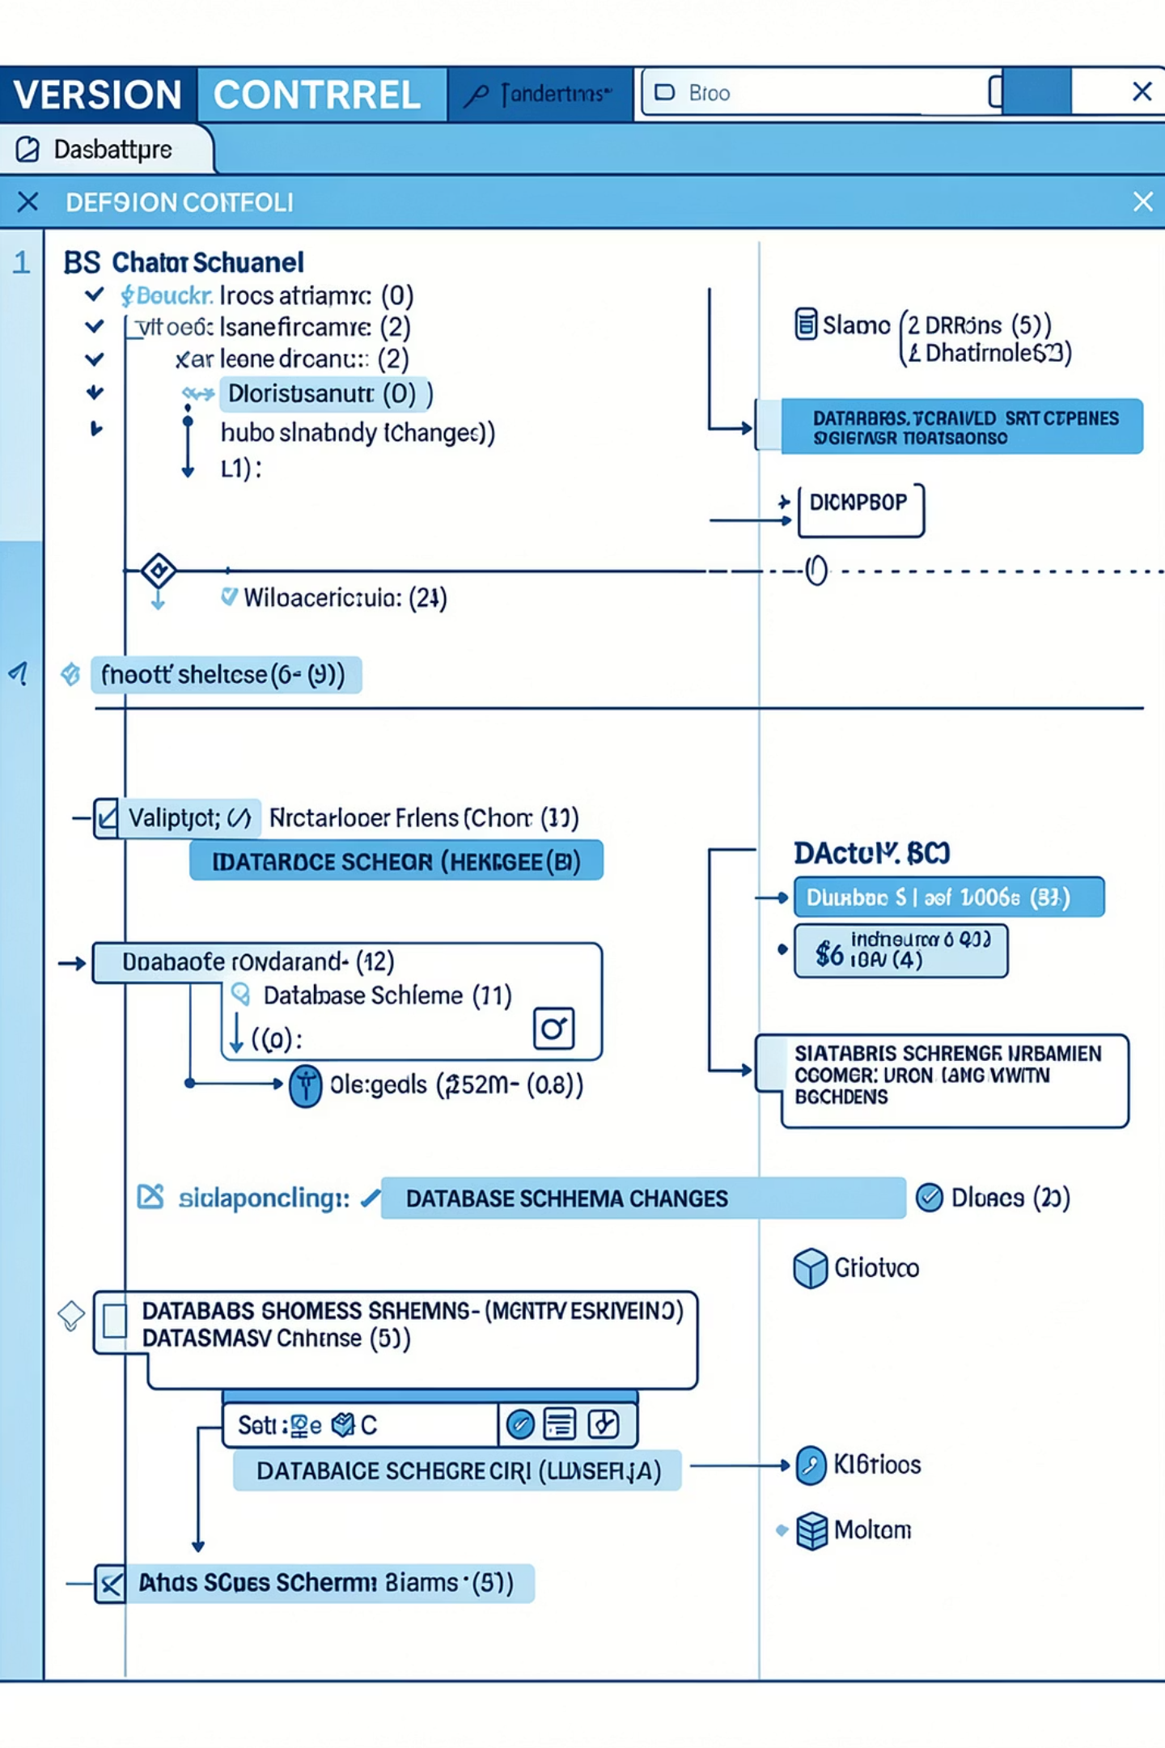
Migrations — Version Control for Your Database
Migrations let you evolve your database schema over time — safely and incrementally — just like Git for your code.
Add-Migration InitialCreate
1
Scaffolds a migration file from your current model
Update-Database
2
Applies pending migrations to the actual database
Add-Migration AddCategory
3
Add a new column later — EF generates the ALTER TABLE for you

Slide 9




Advanced EF Core Concepts
Change Tracking
Transactions
EF Core monitors entity states — Added, Modified, Deleted — and syncs them with one SaveChanges()
Wrap multiple operations in a transaction — all succeed or all roll back, keeping data consistent
Shadow Properties
Global Query Filters
Store data in the database (like CreatedAt) without adding a property to your C# class
Automatically filter data on every query — perfect for soft deletes: .Where(q => !q.IsDeleted)

Slide 10

EF Core in Your Quiz App — What's Next
Your Quiz App Stack
Key Takeaways
Entities: Question, Answer, User, QuizResult
DbContext manages all quiz data
Migrations evolve schema as features grow
LINQ queries fetch questions & scores
ORM Magic
DbContext
C# classes ↔ Database tables, automatically
Your central hub for all data operations
EF Core is your foundation. Master it here, and PPT 2 (Querying & LINQ) will feel natural.
Migrations
Schema version control built in

